Slide 1
Digital Portfolio
STUDENT NAME: Narmatha.P
REGISTER NO AND NMID: 2422k2184 ABE57FA2BB5131289C24880EC58E0DFB
DEPARTMENT: Bsc Computer Science
COLLEGE: COLLEGE/ UNIVERSITY: Puratchi Thalivi Amma Government Arts and Science College/Bharathiyar University

Slide 2
PROJECT TITLE
NARMATHA PORTFOLIO

Slide 3


AGENDTA
Problem Statement
Project Overview
End Users
Tools and Technologies
Portfolio design and Layout
Features and Functionality
Results and Screenshots
Conclusion
Github Link
3/21/2024 Annual Review

Slide 4
PROBLEM STATEMENT
Students often struggle to present their academic achievements, skills, and projects in a structured and professional manner. Traditional resumes fail to capture creativity, practical skills, and hands-on experiences, making it difficult for students to stand out in academic or career opportunities. There is a need for a digital portfolio solution that allows students to effectively showcase their competencies, projects, and growth.

Slide 5

PROJECT OVERVIEW
The problem is usually represented as a cost matrix, where each cell indicates the cost of assigning a specific agent to a task. The most common solution technique is the Hungarian Algorithm (a.k.a. Kuhn-Munkres algorithm), which solves the problem in polynomial time and guarantees an optimal assignment.
By developing this portfolio system,student will have a
personalized digital identity that goes beyond a traditional
CV, enchancing their chances of securing opportunities in
competitive environments. It will also provide academic
institutions and recruiters with a reliable and holistic view
of a students’s potential.

Slide 6

WHO ARE THE END USERS?
1. Employers – To evaluate skills and suitability for jobs
2. Recruiters – To shortlist candidates for interviews
3. Clients – To assess capability for projects or services
4. Collaborators/Team Members – To understand expertise for joint work
5. Educational Institutions – To review achievements for admissions or scholarships.

Slide 7

TOOLS AND TECHNIQUES
Tools:
Trebedit
Techniques:
HTML5
CSS3
JavaScript

Slide 8
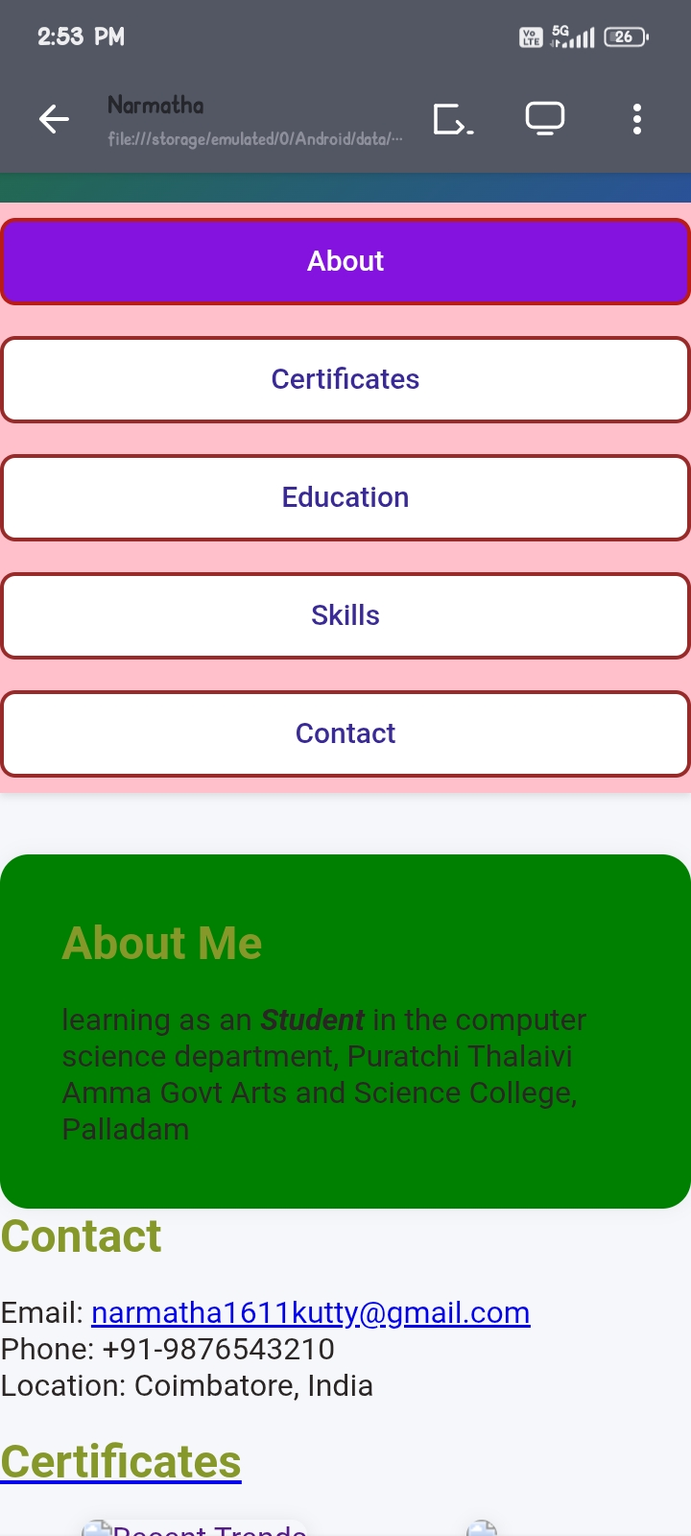
POTFOLIO DESIGN AND LAYOUT
8

Slide 9
FEATURES AND FUNCTIONALITY
Homepage: Welcome, brief intro & navigation About Me:studying an student
Certificate: we developed fundamental
Education:B.sc computer science
Skills: Tech stack visually represented Contact: Form + links to email and social profiles

Slide 10
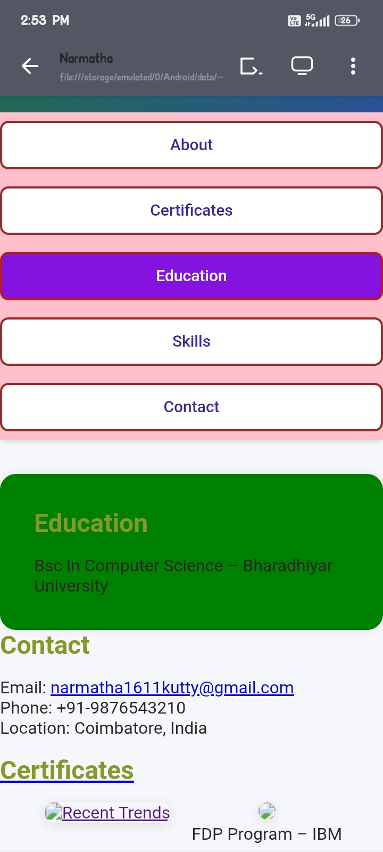
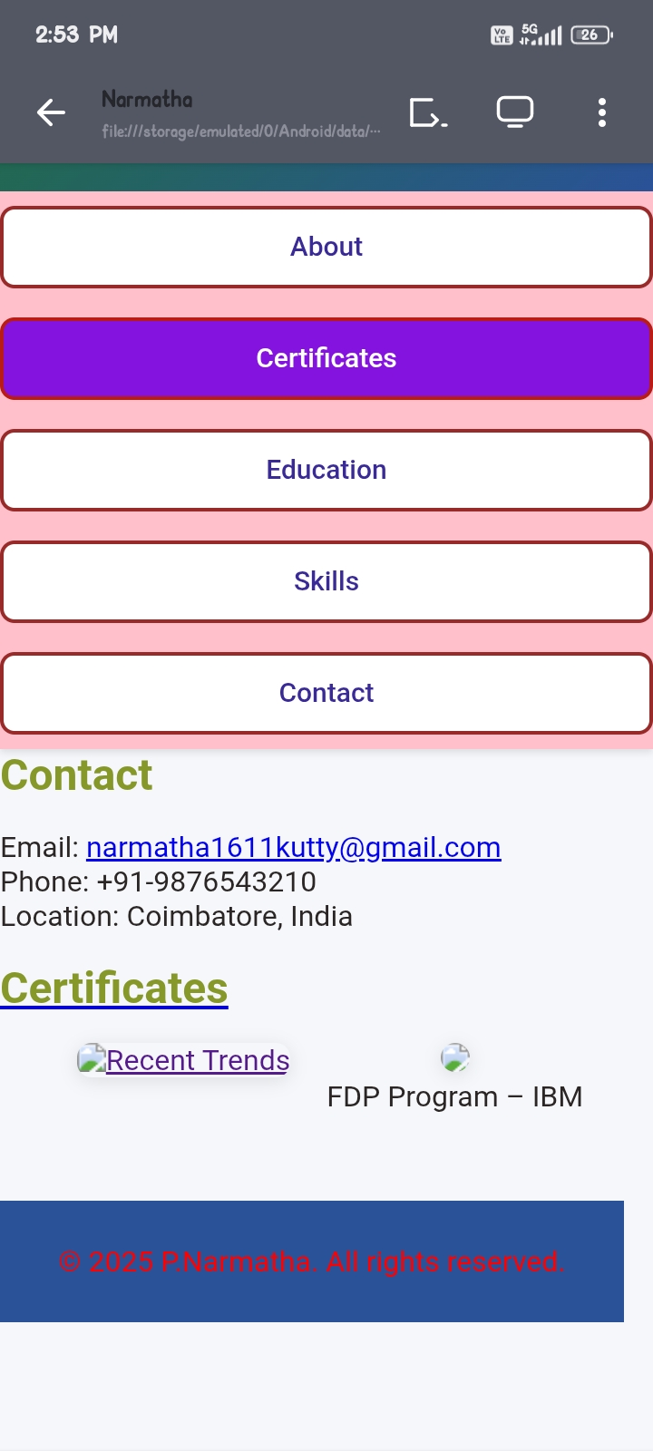

RESULTS AND SCREENSHOTS
3/21/2024 Annual Review
10

Slide 11
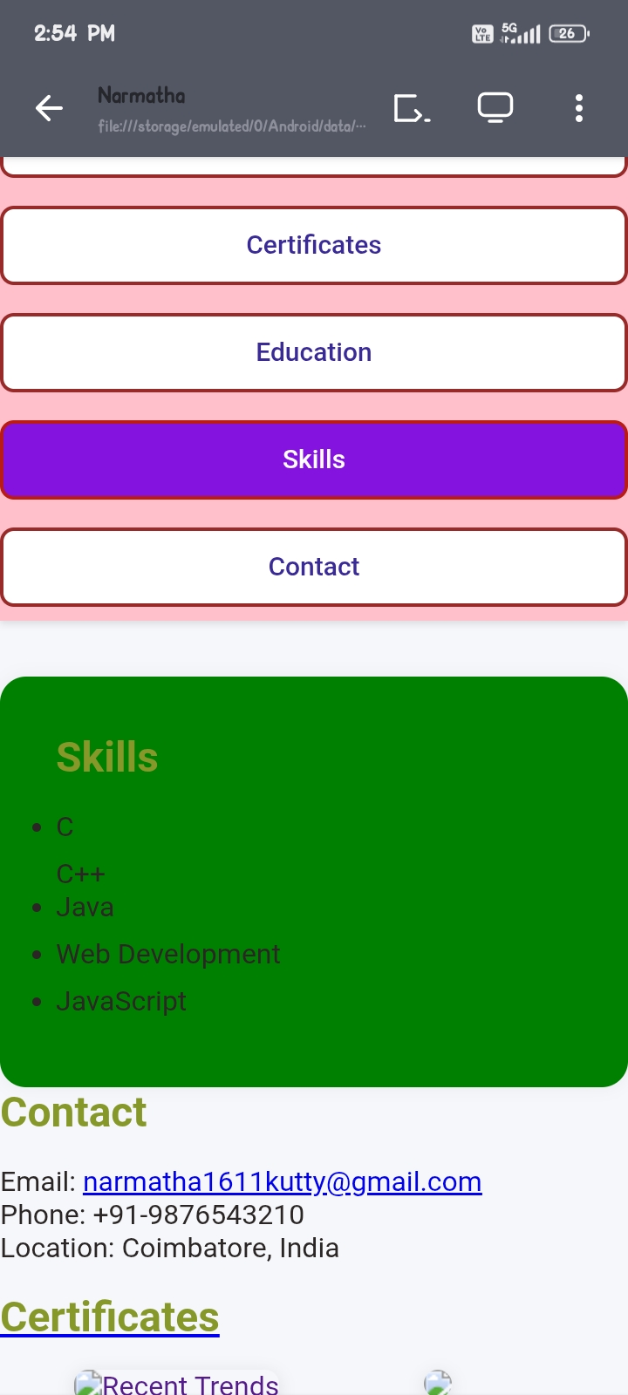
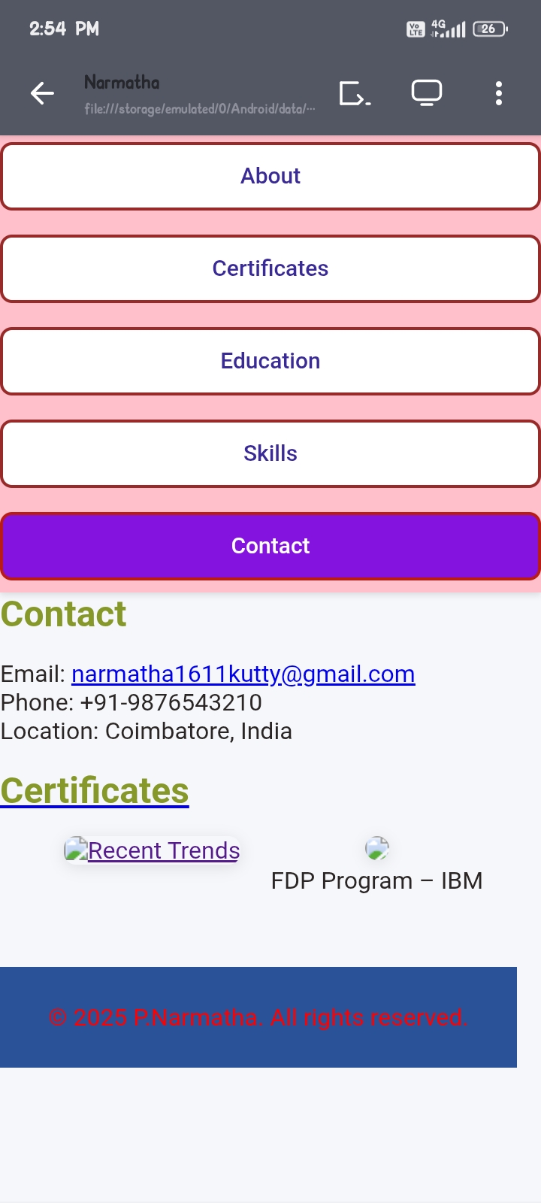
11

Slide 12
CONLUSION
A portfolio serves as a comprehensive showcase of an individual’s skills, projects, and accomplishments in a structured and visually appealing manner. It not only highlights professional and academic achievements but also demonstrates creativity, technical abilities, and personal branding. By providing easy navigation, interactive elements, and responsive design, a portfolio helps create a strong impression on potential employers, clients, or collaborators, making it an essential tool for career growth and opportunities.

Slide 13
GITHUB LINK

Slide 14
Thank You🙏

